Slide 1
Cloud Computing Unit-II

Slide 2
Introduction to cloud services
The cloud is ubiquitous. It’s everywhere even though we rarely notice it.
You interact with the cloud starting first thing in the morning as you check your phone for new emails before you even get out of bed. The cloud is there again when you use your phone’s maps app to check traffic conditions on the way to work.
Once at work, you use the cloud whether you write code using Github as a code repository.

Slide 3
Continue..
Share a document with a colleague using Box, enter customer information into Salesforce, or onboard a new employee using Workday.
When we go home, we may open up vacation photos a friend sent to us on Dropbox without giving it a second thought that we are consuming a cloud service built on top of another cloud service (Dropbox is built on Amazon AWS).

Slide 4
What is a cloud service?
The term "cloud services" refers to a wide range of services delivered on demand to companies and customers over the internet. These services are designed to provide easy, affordable access to applications and resources, without the need for internal infrastructure or hardware.
From checking email to collaborating on documents, most employees use cloud services throughout the workday, whether they’re aware of it or not.
Cloud services are designed to provide easy, scalable access to applications, resources and services, and are fully managed by a cloud services provider.

Slide 5
Question
Which of the following is a type of Service Models?
A. Public-as-a-Service
B. Platform-as-a-Service
C. Community-as-a-Service
D. None of the above

Slide 6
How do cloud services work?
Cloud services are fully managed by cloud computing vendors and service providers. They’re made available to customers from the providers' servers, so there's no need for a company to host the applications on its own on-premises servers.
A cloud service is any service made available to users on demand via the Internet from a cloud computing provider's servers as opposed to being provided from a company's own on-premises servers.

Slide 7
Continue..
Virtualization- cloud computing utilizes server and storage virtualization extensively to allocate/reallocate resources rapidly.
Multi-tenancy- resources are pooled and shared among multiple users to gain economies of scale.
Network-access- resources are accessed via web-browser or thin client using a variety of networked devices (computer, tablet, smartphone).
On demand- resources are self-provisioned from an online catalogue of pre-defined configurations.
Elastic- resources can scale up or down, automatically.
Metering/chargeback- resource usage is tracked and billed based on service arrangement.

Slide 8
Who uses cloud computing services and why?
Corporate and government entities utilize cloud computing services to address a variety of application and infrastructure needs such as CRM, database, compute, and data storage.
Cloud computing services deliver IT resources in minutes to hours and align costs to actual usage. As a result, organizations have greater agility and can manage expenses more efficiently.
Similarly, consumers utilize cloud computing services to simplify application utilization, store, share, and protect content, and enable access from any web-connected device.

Slide 9
What are the benefits of cloud services?
Faster implementation and time to value
Anywhere access to applications and content
Rapid scalability to meet demand
Higher utilization of infrastructure investments
Lower infrastructure, energy, and facility costs
Greater IT staff productivity and across organization
Enhanced security and protection of information assets

Slide 10
What’s the future of cloud services?
As the availability of cloud services continues to expand, so will their applications in the corporate world.
Whether a company chooses to extend existing on-premises software deployments or move 100% to the cloud, these services will continue to simplify how organizations deliver mission-critical apps and data to the workforce.
From content collaboration and access control for employees to app delivery management and virtual desktop solutions for IT, plus a vast array of options in between, cloud services are transforming how people work and the ways businesses operate.

Slide 11
Question
________________ is yet another service model, which includes Network-as-a-Service, Business-as-a-Service, Identity-as-a-Service, Database-as-a-Service or Strategy-as-a-Service.
A. IaaS
B. PaaS
C. SaaS
D. XaaS

Slide 12
IaaS
Infrastructure as a service also called hardware as a service.
Virtualized resources (CPU, Memory, Storage etc.) are used (on pay per use basis) by applications.
It helps you avoid the expense and complexity of buying and managing your own physical servers and other datacentre infrastructure.
Currently, the most high-profile IaaS operation is Amazon’s Elastic Compute Cloud (Amazon EC2). It provides a Web interface that allows customers to access virtual machines. EC2 offers scalability under the user’s control with the user paying for resources by the hour.

Slide 13
Common IaaS business scenarios
Test and development. Test environment can be quickly set up and dismantle test bringing new applications to market faster.
Website hosting. Running websites using IaaS can be less expensive than traditional web hosting.
Storage, backup and recovery. Organizations avoid the capital outlay for storage and complexity of storage management. IaaS is useful for handling unpredictable demand and steadily growing storage needs. It can also simplify planning and management of backup and recovery systems.

Slide 14
Continue..
High-performance computing. High-performance computing (HPC) on supercomputers, computer grids or computer clusters helps solve complex problems involving millions of variables or calculations. Examples include earthquake and protein folding simulations, climate and weather predictions, financial modeling and evaluating product designs.
Big data analysis. Big data is a popular term for massive data sets that contain potentially valuable patterns, trends and associations. Mining data sets to locate or tease out these hidden patterns requires a huge amount of processing power, which IaaS economically provides.

Slide 15
Question
Which of the following is the least preferable cloud computing in demand?
Paas
Saas
Iaas
Haas

Slide 16
IaaS Benefits
Cost Savings –moving to cloud means lower Infrastructure costs, no maintenance overhead and no need to worry about ensuring uptime. The pay-as-you-go model of cloud offers significant cost savings since organizations pay only for what they use. The IaaS model demands no upfront charges, bandwidth utilization fees or minimum term commitments.
Focus on business growth - Moving to the cloud saves precious time that was being used to deal with maintenance issues and helps the business focus on growth.

Slide 17
Continue..
Faster Time to Market –time to market is the best way to beat competition. The scalability and flexibility IaaS provides et the service or product rapidly to the market.
Support for DR, BC and high availability -Every enterprise requires a Disaster Recovery and Business Continuity plan in place. However, the technology behind these is often quite expensive and for organizations with more than one location managing of this infrastructure becomes more difficult. IaaS provides a consolidated Disaster Recovery infrastructure which ensures quick recovery with no loss of data.

Slide 18
Continue..
Scalability and Flexibility - the most important benefit of IaaS is the ability to scale up and down depending on the enterprise’s requirements. This on demand scalability results in flexibility and agility to respond to changing opportunities. This scalability also help in quickly building and dismantling test and development can help in the getting the job done faster.

Slide 19
IaaS Risks
Privacy and Security in the Cloud: One of the biggest concerns a business has while adopting IaaS is the security of confidential enterprise data and information. The credibility of the service provider is of utmost importance, the business must evaluate all possible alternatives before choosing one.
Limited Control and Flexibility: IaaS means business has limited control over the execution of software and hardware that run on virtual environments.

Slide 20
Continue..
Downtime and Technical Difficulties: Systems face dysfunction and issues from time to time. Besides access to cloud is completely dependent on internet access, any connectivity issues will render the whole system useless.
Increased Vulnerability: Cloud-based solutions have a greater risk of attacks from malicious users and hackers.

Slide 21
Infrastructure as a Service Some examples are:
Infrastructure as service or IaaS is the basic layer in cloud computing model. Common examples:
Digital Ocean
Linode
Rackspace
Amazon Web Services (AWS)
Cisco Metapod
Microsoft Azure
Google Compute Engine (GCE) are some popular examples of Iaas.

Slide 22
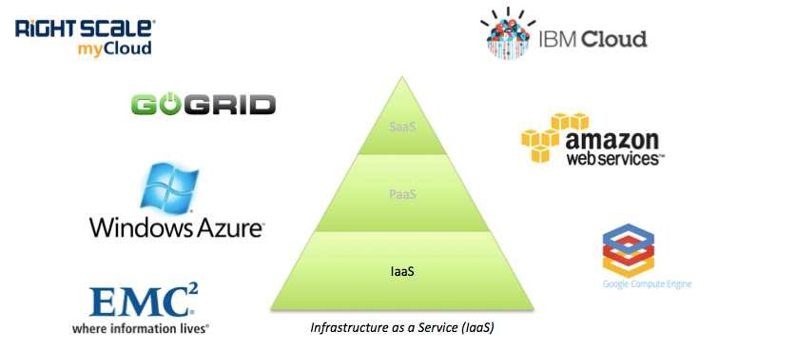

Slide 23
Question
Which of the following is an example of an IaaS Cloud service?
a) DigitalOcean
b) Linode
c) Rackspace
d) All of the above

Slide 24
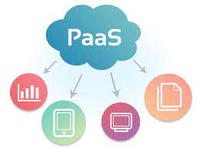
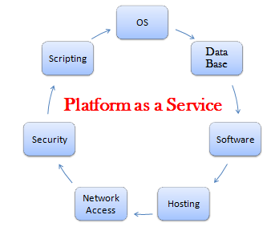
PaaS – Platform as a Service
Platform as a service (PaaS) is a complete development and deployment environment in the cloud with resources that enable you to deliver everything from simple cloud-based apps to sophisticated, cloud-enabled enterprise applications.
You purchase the resources you need from a cloud service provider on a pay-as-you-go basis and access them over a secure Internet connection.

Slide 25
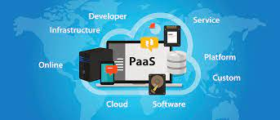
Who can benefit from PaaS?
Software developers: can take advantage of a PaaS solution to build an application which they are planning to offer over the internet.
Web developers: can use individual PaaS environments at every stage of the process to develop, test, and host their websites.
Businesses: can develop their own internal software, particularly to create distinct ring-fenced development and testing environments.

Slide 26
PaaS –Platform as a Service
PaaS includes:
1.Infrastructure such as servers, storage and networking.
2.Middleware (such as IIS, Tomcat, Caching Services)
3.Development tools
4.Business Intelligence (BI) services
5.Database management systems (SQL Server, Oracle, MySQL)
6.Runtime(JRE and .NET Framework)
PaaS is designed to support the complete web application lifecycle:
Building, Testing, Deploying, Managing and Updating.

Slide 27
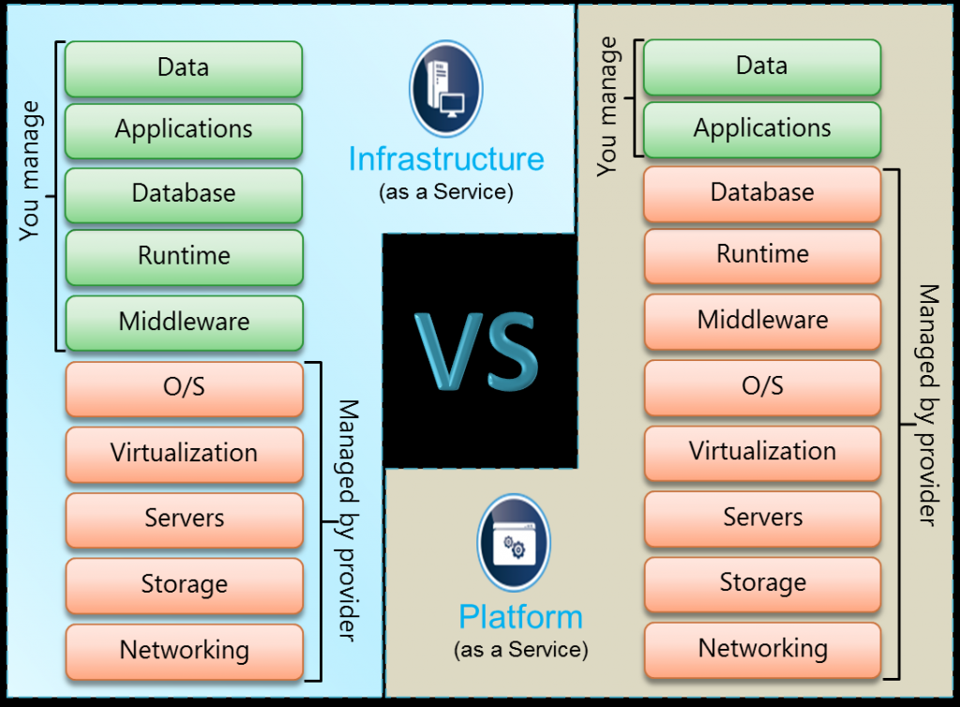
IaaS vs. PaaS

Slide 28
IaaS vs. PaaS
IaaS Examples include:
Amazon EC2
Windows Azure
Rackspace
Google Compute Engine
PaaS Examples include:
Windows Azure
Force.com
NETSUITE
AT&T

Slide 29
PaaS Benefits
Reduced Development Time: The server side components such as web servers, storage, and networking are provided by the PaaS provider. The development team need not configure or maintain them. This saves time and results in faster development.
Support for Different Programming Languages: PaaS services support many different programming languages allowing the developers to develop simple web applications to enterprise cloud solutions on the same platform.

Slide 30
Continue..
Easy Collaboration for Remote and Distributed Teams: In today’s world of freelancing and outsourcing, software development team may be distributed over different locations all over the world. PaaS services make it possible for these distributed teams to collaborate and allows them to access the same software platform from anywhere and at any time.
High Development Capabilities without Additional Staff: PaaS providers provide, maintain, and upgrade all hardware and middleware, thus eliminating the need for staff to do all these tasks.

Slide 31
PaaS Risks
Although PaaS services have many benefits, they also come with some disadvantages:
You have no control over the virtual machine that processes your data.
PaaS solutions are less flexible than IaaS. For example, you cannot create and delete several virtual machines at a time.
It comes with a predefined programming model which can result in vendor lock-in issues since you have to use only the languages offered.
Migration to the cloud can be difficult if the existing code is not supported by the provider.

Slide 32
Software as a Service –SaaS
Software as a service (SaaS) allows users to connect to and use cloud-based apps over the Internet. Common examples are email, calendaring, and office tools such as Microsoft Office 365.)
SaaS provides a complete software solution which you purchase on a pay-as-you-go basis from a cloud service provider.

Slide 33
Continue..
You rent the use of an app for your organization and your users connect to it over the Internet, usually with a web browser. All of the underlying infrastructure, middleware, app software, and app data are located in the service provider’s data center.
The service provider manages the hardware and software and with the appropriate service agreement will ensure the availability and the security of the app and your data as well. SaaS allows your organization to get quickly up and running with an app at minimal upfront cost.

Slide 34
Traditional Software vs SaaS
SaaS products are generally prebuilt and consumed using the provided functionality without significant customization, as in the case of Google Gmail users who simply access the web-based standard email and calendaring application.

Slide 35
Traditional Software vs SaaS
Traditional software requires a capital expense to purchase and operating expenses to install, update, and maintain. Traditional software application management follows a predictable process:
1.Identify software meeting requirements.
2.Perform capital acquisition for identified software.
3.Install software to client computers.
4.Patch software in maintenance cycle.
5.Perform acquisition for software update.
6.Install software update to client computers.
7.Return to maintenance cycle until next software update.

Slide 36
Traditional Software vs SaaS
By contrast, SaaS application management requires far fewer steps for the consuming organization:
1.Identify cloud service providers whose software meets organizational requirements.
2.Obtain licensing for identified software service access. After this, all maintenance, including patches and updates, are handled by the cloud SaaS provider.

Slide 37
SaaS Benefits
Business agility is enhanced by ensuring that mobile workers have access to key business applications from anywhere anytime.
Displaced employees retain operational capability during widespread natural disasters, and organizational data resources can simply be moved to cloud provider storage outside of the affected area in case of a disaster.

Slide 38
SaaS Benefits
Organizations can take advantage of resource sharing between employees working in different time zones or across different geopolitical zones.
Organizations can implement sustainable “green” initiatives such as remote travel-free employees, who do not require leased space, dedicated equipment, and costly environmental control in expensive central office facilities.

Slide 39
SaaS Risks
Usage Risk: The risk an organization incurs when using the app such as using it for some critical function or for storing sensitive information will be considered high risk. Whereas an app for say scheduling get together for employees with pets will be considered low risk.
Data Security Risk: While Usage Risk focuses on how your organization is using the app, Data Security Risk focuses on how the service provider is handling your data. It is crucial to know whether it is encrypted in transit or at rest and whether the app controls are in place to determine how the data are stored and who can view it.

Slide 40
SaaS Risks
SaaS Provider Operational Risk: This includes issues such as the uptime SLA guaranteed by the provider, whether there is 24×7 support, the compliance certificates obtained by the provider and the Disaster Recovery strategy of the provider.
SaaS Provider Application Risk: Application risk is the inherent risk of an app such as how the app handles authentication and authorization? The development practices used by the provider to address configuration vulnerabilities and session management vulnerabilities.

Slide 41
Examples
Platform as a Service –Some examples are:
Salesforce.com
Office 365
Zoho
Google G Suite

